Slide 1
PDETS Office Hour

Slide 2
Content Engineering Services
Provide engineering services for Content Development to:
Pre-Production
Instance creation
Git Repo structure creation
Course image creation
About page & assets review
Assembly
Advanced MD Settings
Interactive page creation
Video upload/encode
Video mapping creation
Referral URLs creation
Survey & Links creation
CC Creation & Mgmt
edX/Open edX/MVA
Sampling QA
10 biz days SLA
Animation/Graphics
/Video editing | review
edX/Open edX
MVA
1. Free up Capacity
Online Content Test
Components & links
Lab steps
Assessment
Course settings check
Publish & Repurpose
edX/Open edX/ELMS
Partners
First run & Re-run
Release ( visibility, aka links)
TA Support
edX
Review & tech support
Tools & Sample code
Auto-Assembly
CC Portal
Survey Collector
TFS ScrumBoard
New Markdown tags
2. Drive Efficiency
3. Secure Quality
MoD/MOC Support
MoD assembly & test
Lab/VM/content Test
Build/BAS support
CWAT Support
XML publish
Loc Eng. Support
Efficient VM solutions
Base/midtier creation
Assembly
Eng. Solutions with git
Content SE Mgmt.
All LOB (except exam)
Misc.
MSIA Support
Exam test
One time project
4. Improve Student SAT
5. Save Cost
Content Engineering Service Scope

Slide 3
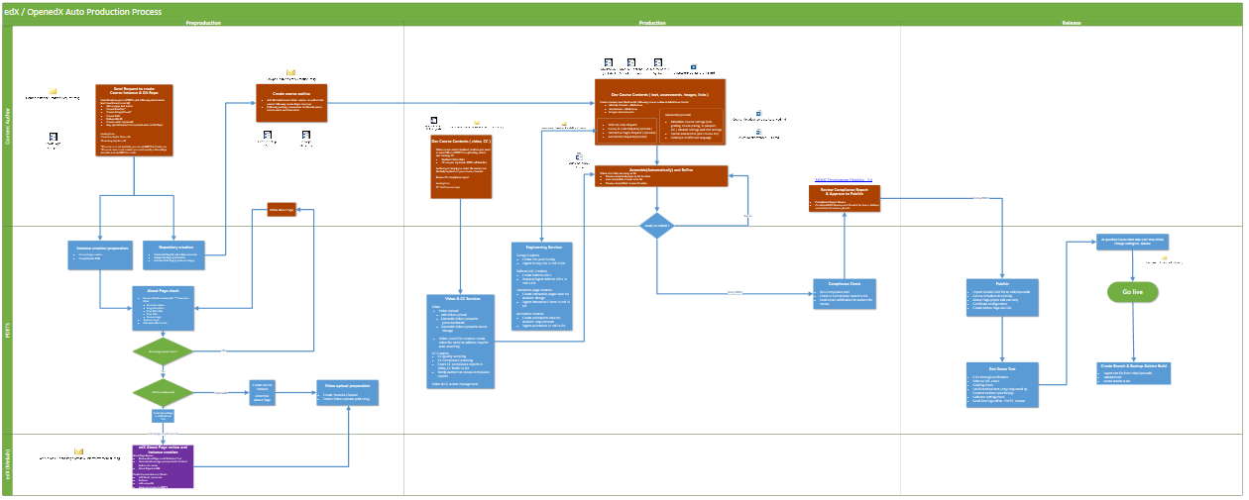
edX/Open edX process

Slide 4
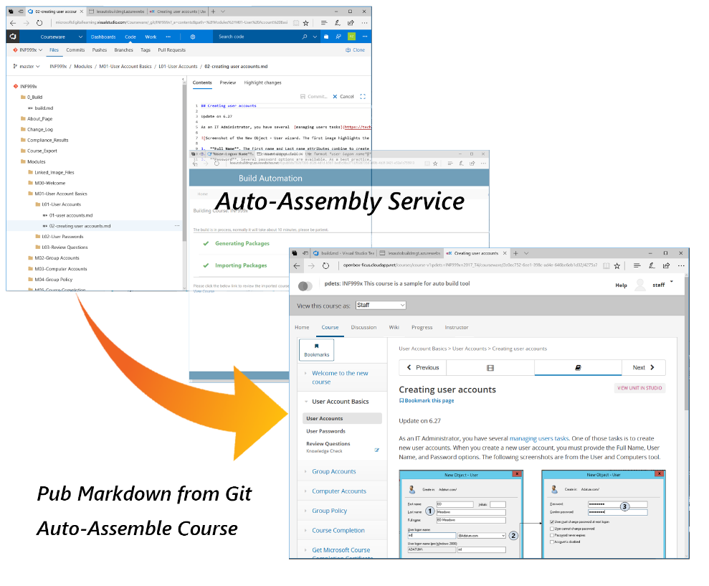
Auto-Assembly Tool
Assemble a course within just 10 minutes by yourselves.
Have WYSIWYG feature.
Support both Classic and Advanced Mode
Support color coding for all programming languages
Make easy version control in Git for all content changes;
Notes:
Assemble a course within just 10 minutes by yourselves.( Manual assembly takes 4 business days );
Use the WYSIWYG feature. Authors can preview the course by individual pages or by an entire course on the staging server;
Support both Classic ( all settings are standard, no actions for Authors) and Advanced ( sophisticated course and content settings via metadata files ) Markdown sources;
Support color coding for all programming languages to enhance student experience;
Make easy version control in Git for all content changes;

Slide 5
Auto-Assembly Tool
edX
Preview Courses
Staging
Environment
MarkDown
Naming Conversion
Folder Structure
OpenedX
Golden Tar
PDETs Team
Edit
Build
Manually Publish
Check in
Git
Content
Authors
Partner edX…
Preview
single pages in Git
edX Tar file
Json
XML
HTML
Azure
Other Platform…
Auto–Assembly Tool

Slide 6
Demo INF999x_Git_Repo INF 999x _Staging

Slide 7
Resource
Auto-Assembly User Guide
Sample course:INF 999x
Content Development Task Checklist (Infographics version) (Word Version)
Staging environment account
Email: AutoAssembly@outlook.com; Password: Pa$$w0rd.

Slide 8
Features
Markdown content publish
Assessment : Embedded /Library
Course Advanced settings
LTI support
Coloring code
Azure Media Service support

